Slide 1
CS 384 Project Management
Prj. Management
Collaborative Writing

Slide 2
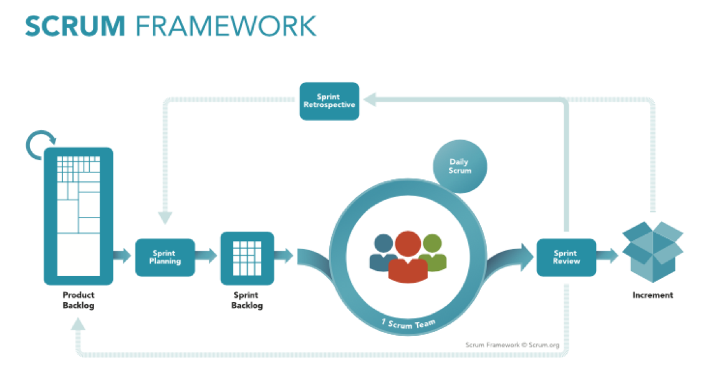
Modified Scrum
For SRS and SDD you will be using Scrum Development Method or derive version of it.
You will create a weekly Sprint backlog(Planned, Working, Complete), using
Monday a Planning Meeting (estimating tasks), and
Daily standups (Achievements, Plan, and Blocks)
Friday a Sprint Review( demos and velocity reports, retrospect)
The entire class should have a backlog and the individual groups can if they want.
How you choose to implement it is up to you program.

Slide 3
Small Projects vs Large Projects
Coding
HW Assignments
Ponder Projects
Sr Project
MS Office
OS: Kernal
Communication
Date Night
Group Date
Party
Church Activity
Family reunion
Meal Planning
Meeting Scheduling

Slide 4
Collaborative Writing

Slide 5
Collaborative Writing
Cover:
P. Lowry et al., "Building a Taxonomy and Nomenclature of Collaborative Writing to Improve Interdisciplinary Research and Practice," Journal of Business Communication, vol. 41 no. 1, pp. 66-99, Jan. 2004 [Online] Available: http://job.sagepub.com/content/41/1/66.full.pdf

Slide 6
P. Lowry et al., "Building a Taxonomy and Nomenclature of Collaborative Writing to Improve Interdisciplinary Research and Practice," Journal of Business Communication, vol. 41 no. 1, pp. 66-99, Jan. 2004 [Online] Available: http://job.sagepub.com/content/41/1/66.full.pdf

Slide 7
Abstract
This article provides a taxonomy of, nomenclature for, and discussion of
issues related to collaborative writing.
The goal is to enhance its research, improve its application in academia and industry, and help
produce technologies that better support collaborative writing.
To write collaboratively and build supportive technologies, practitioners and academics need to use a
consistent nomenclature and taxonomy of collaborative writing.
This article defines key collaborative writing terms and builds a taxonomy, including collaborative
writing activities, strategies, control modes, work modes, and roles.
This article stresses that effective choices in group awareness, participation, and coordination are critical to successful collaborative writing outcomes, and that these outcomes may be promoted through collaborative writing
software, chat software, face-to-face meetings, and group processes.

Slide 8
Outline
Overview
Define CW
A Taxonomy of CW
CW Strategies
CW Activities
Document Control Modes
CW Roles
CW Work Modes
Example Application: Applying Taxonomy To Technology
Research Opportunities
CW Strategies
CW Roles
CW Activities
Conclusion
Notes

Slide 9
Overview
The lack of an interdisciplinary approach and common understanding of CW undermines the ability of researchers and practitioners to solve the core issues of CW, which require interdisciplinary collaboration for resolution.

Slide 10
Define CW
Describe the three cognitive processes in single-author writing as planning, translation, and reviewing.
CW builds on single-author writing by involving multiple people, thus increasing the complexity of the writing process (Galegher&Kraut, 1994).
The increased complexity can be further explained in terms of social complexity, intellectual complexity, and procedural complexity (Galegher & Kraut, 1994).
CW group members commonly show great enthusiasm in the brainstorming and planning stages, but their commitment can wane in writing tasks that take place over extended periods.

Slide 11
Define CW
Lay (Lay & Karis, 1991) provides several other reasons why CW can be complex, including
(a) CW documents are complex artifacts,
(b) processes of preparing documents are more multifaceted under collaboration,
(c) writing processes generate strong emotions,
(d) groups can revise CW documents infinitely, (RISK)
(e) it is challenging for collaborative writers to converge toward a common goal and understanding of a document or even use a common language, and
(f) success in CW is difficult to predict and guarantee.

Slide 12
Define CW
CW researchers and practitioners do not even agree on a common term for CW.
We build the basis of our definition of CW and taxonomy by leveraging six axioms, proposed as follows:
(a) Single-author writing involves the minimum activities of planning, drafting, and revising;
(b) CW extends on single-author writing by involving multiple parties and the minimum activities of planning, drafting, and revising;
(c) by involving multiple parties working toward a common writing task, CW becomes a group and social act that requires other activities not involved in single-author writing, such as building consensus;
(d) once multiple people are working toward one writing task, an effective CW experience will then require communicating, negotiating, coordinating, group researching, monitoring, rewarding, punishing, recording, socializing, and so forth, as supported by substantial research on the importance of effective group dynamics in CW tasks (Ede & Lunsford, 1990; Forman & Katsky, 1986; Locker, 1992);
(e) building on group literature (Dubs&Hayne, 1992), any optimally performed group task should include pretask activities to set up for the task (e.g., group formation) and posttask activities to finalize the task delivery, as has been documented in studentCWgroups (Bogert & Butt, 1990); and
(f) group tasks, and thus CW, should include team formation, team planning (Burnett, 1990), execution of the desired task, and finalization of the task (Dubs&Hayne, 1992).CWresearch supports that writing tasks cannot be separate from key group activities without negative repercussions (Anderson, 1989; Bovee & Thill, 1989; Duin, 1990; Forman & Kelly, 1990; Johnson & Johnson, 1987; Locker, 1989).

Slide 13
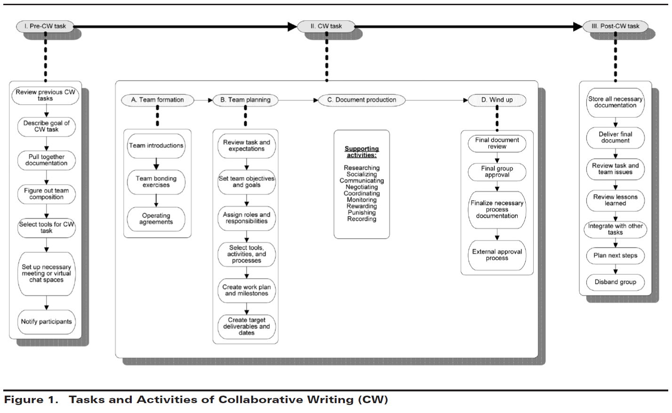
Define CW

Slide 14
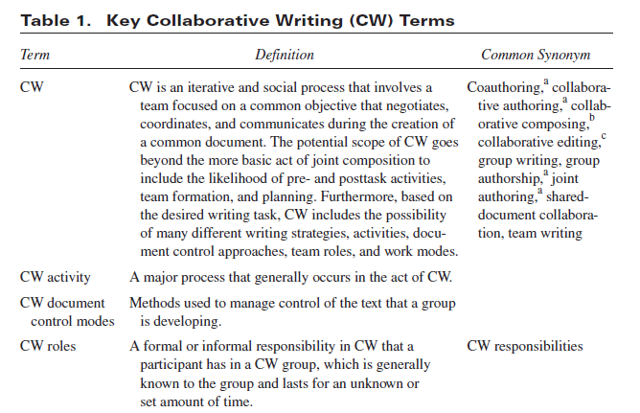
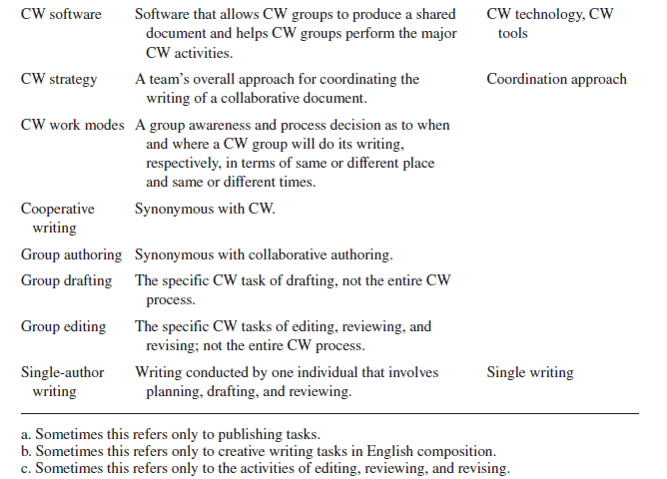
A TAXONOMY OF CW - CW Strategies

Slide 15
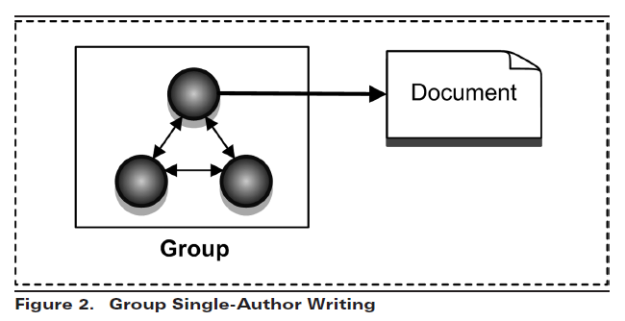
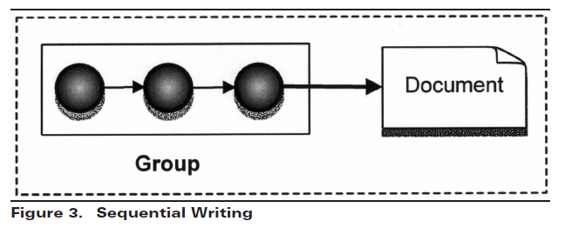
A TAXONOMY OF CW - CW Strategies

Slide 16
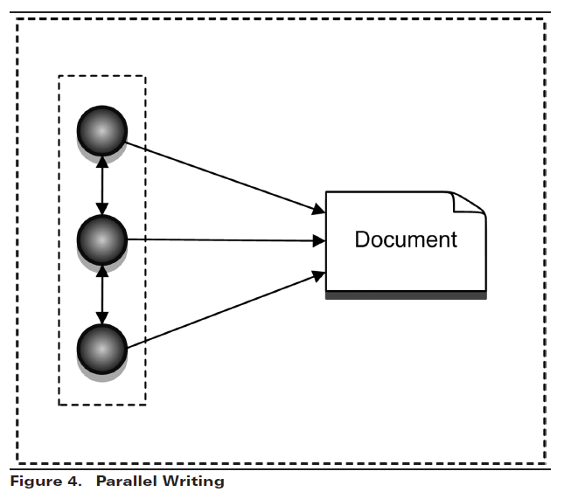
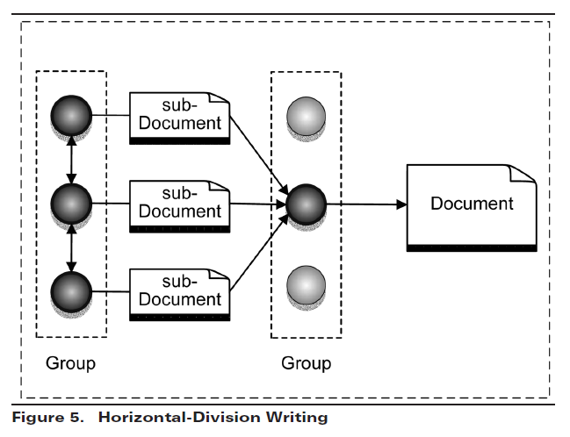
A TAXONOMY OF CW - CW Strategies

Slide 17
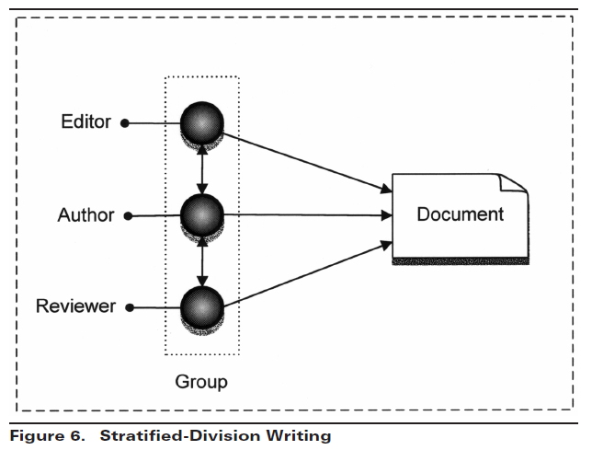
A TAXONOMY OF CW - CW Strategies

Slide 18
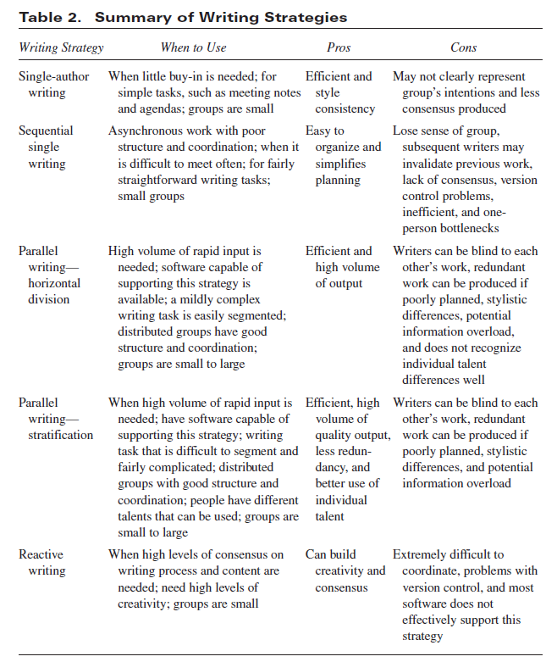
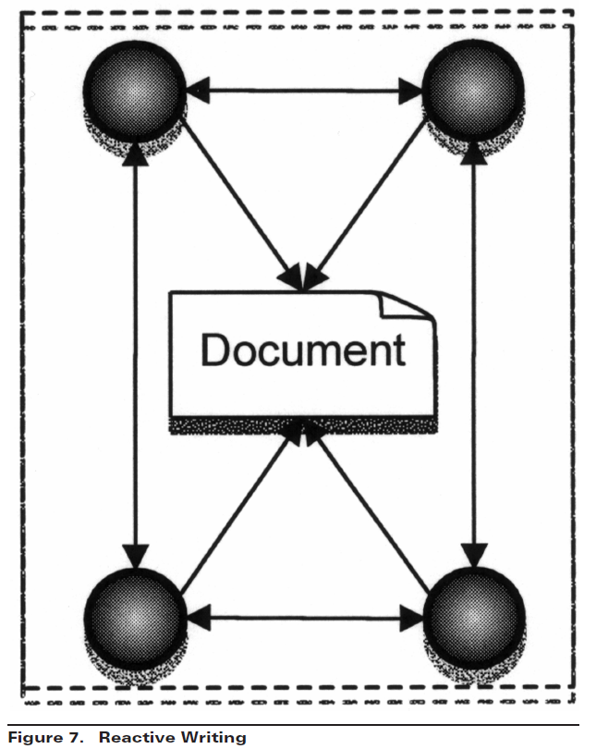
A TAXONOMY OF CW - CW Activities

Slide 19
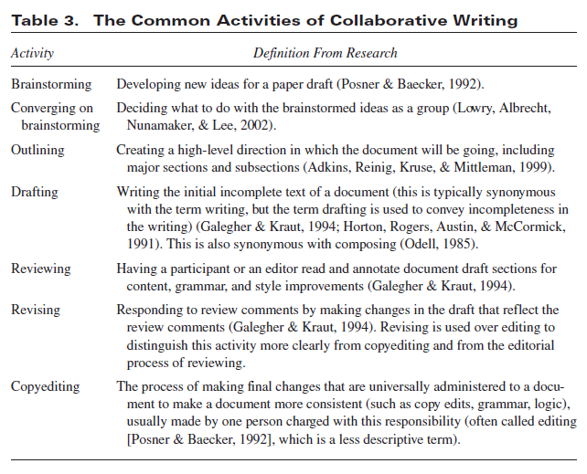

Slide 22
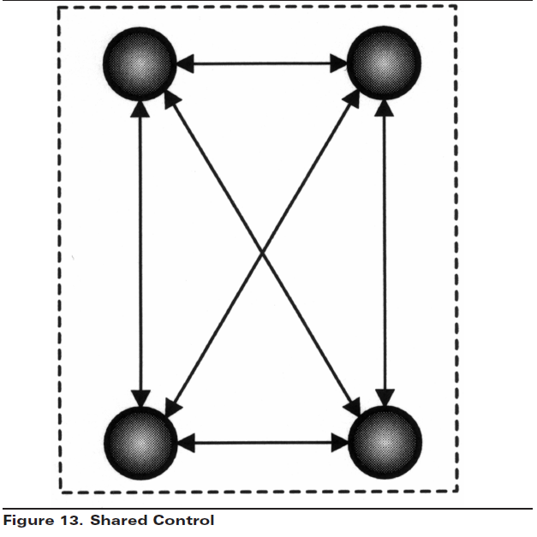
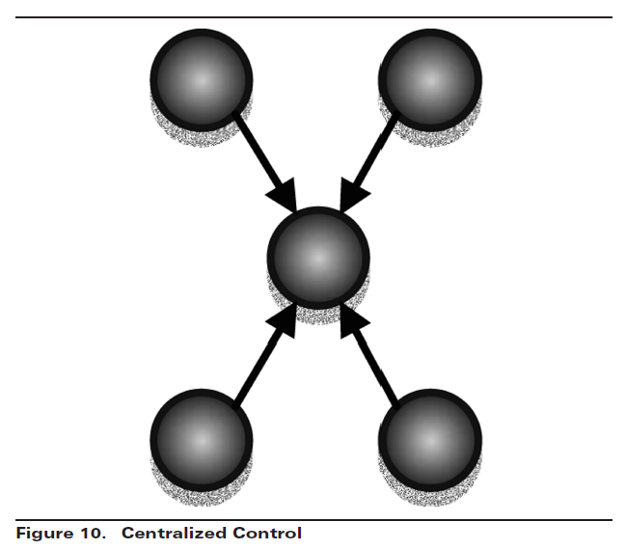
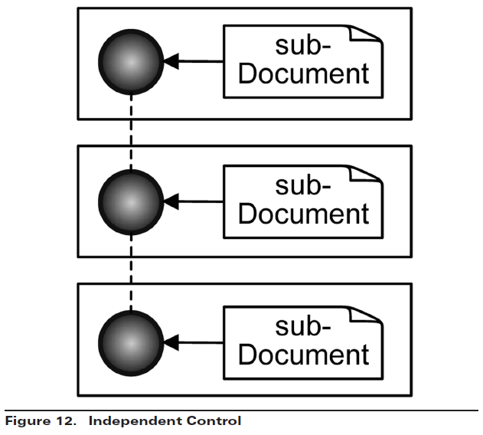
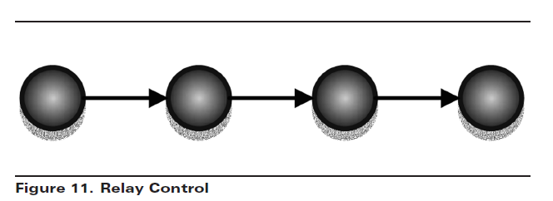
A TAXONOMY OF CW

Slide 23
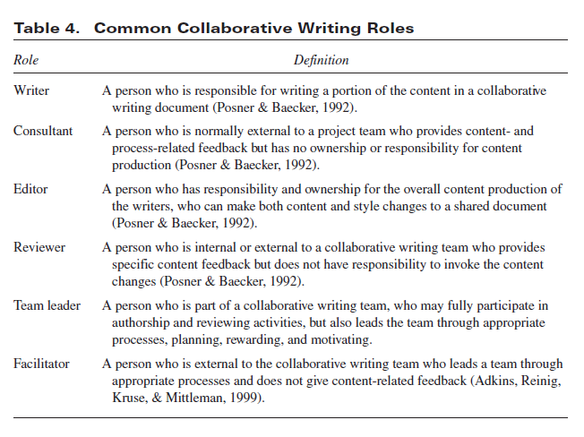
A TAXONOMY OF CW - CW Roles

Slide 24
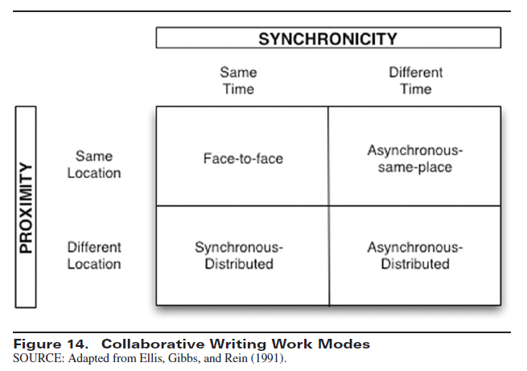
A TAXONOMY OF CW - CW Work Modes

Slide 25
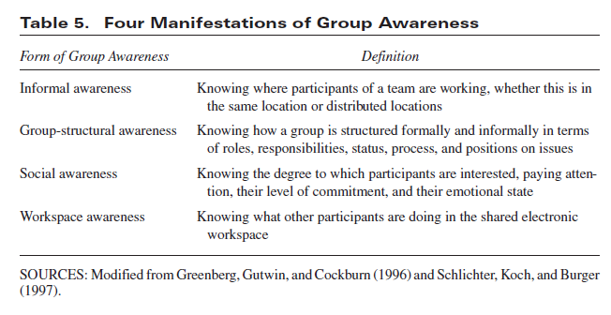
EXAMPLE APPLICATION: APPLYING TAXONOMY TO TECHNOLOGY

Slide 26
Figure 15. Collaborative Technologies Overview

Slide 27
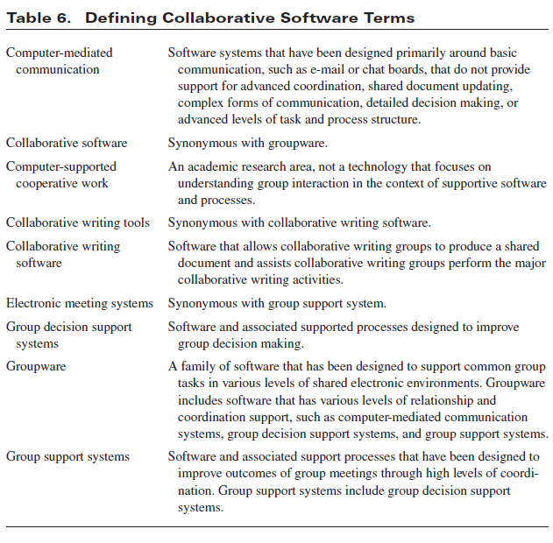

Slide 28
RESEARCH OPPORTUNITIES - CW Strategies
We define reactive writing as a
strategy that occurs when writers
create a document in real time.

